Slide 1
User Info

Slide 2
Linux Commands Used in This Lab
Command | Purpose | Command Syntax Used | Explanation
date | To display or set the system date and time | date -u -d @1698016596 | Display convert epoch time to UTC -u => the output should be in Coordinated Universal Time (UTC) -d => to specify a date string or timestamp @ => to indicate that the following value is a timestamp
bulk_extractor | To analyze disk images, files, or directories to identify and extract information such as email addresses, credit card numbers, URLs etc. | bulk_extractor disk_image.img | Extract information such as email addresses, credit card numbers, URLs etc. from disk image disk_image.img

Slide 3
Types of Users in Android / Fire OS
Each user on an Android/Fire OS device is assigned a unique numerical identifier known as a User ID.
The primary user, often the device owner, is assigned the User ID 0 (zero), also known as the "system" user.
Additional users are assigned User IDs starting from 10

Slide 4
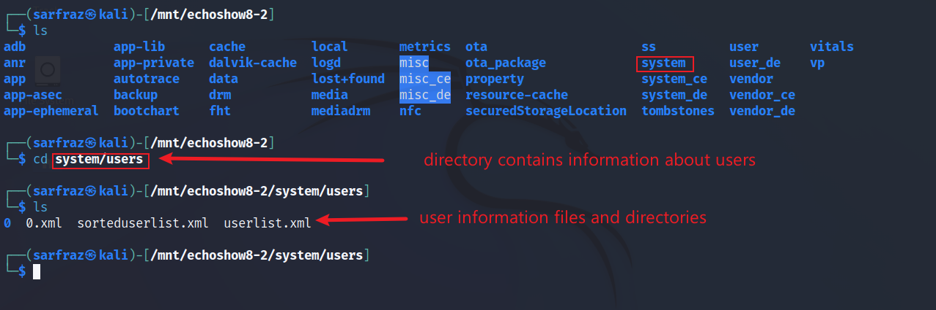
List of Users
User-related information can be found in directory /system/users.
List files in /system/users directory

Slide 5
User Information Files
File | Description
0.xml | Information about the primary user It contains elements such as name, icon, flags, serial number, etc. that identify the primary user and its settings
userlist.xml | Information about users created on the device like User ID
sorteduserlist.xml | List of user IDs

Slide 6
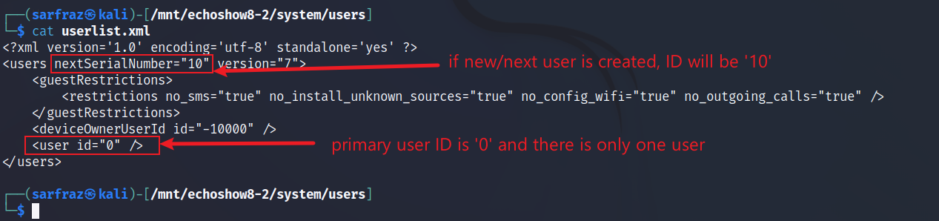
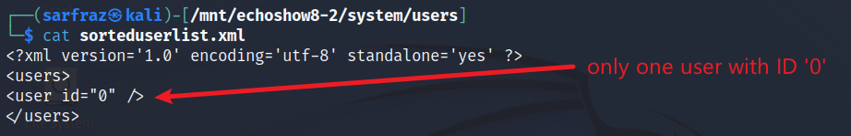
List of Users
Display contents of userlist.xml file
Display contents of sorteduserlist.xml file

Slide 7
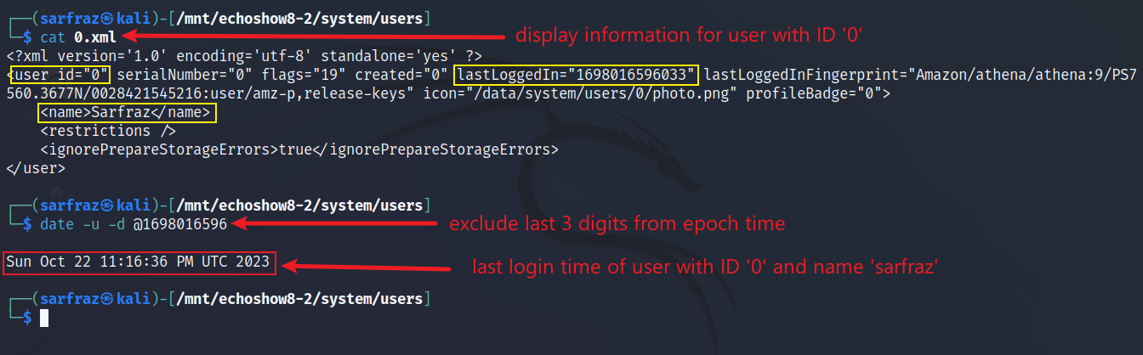
Name of User (Primary User with ID ‘0’)
Name = Sarfraz
Last login time = 7:16 pm on Oct 22, 2023 EDT
Display contents of 0.xml file

Slide 8
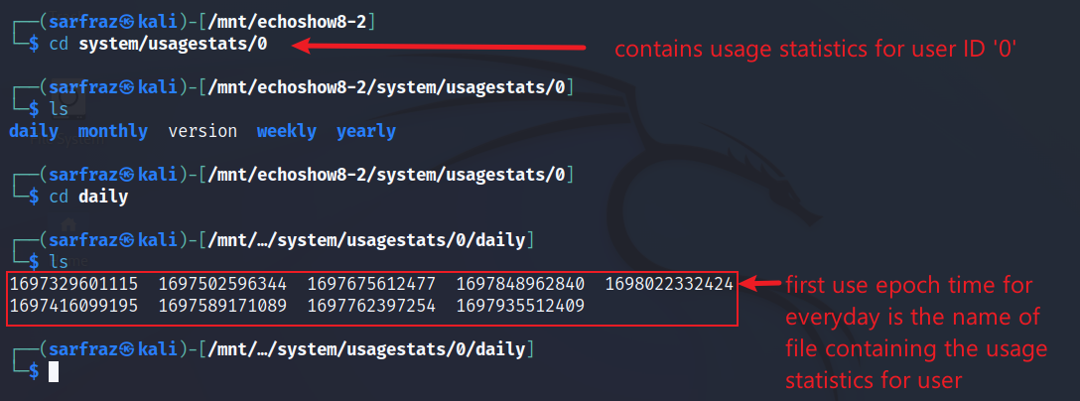
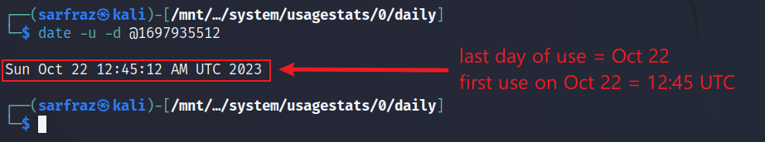
User Activity Statistics
List contents /system/usagestats/0 directory
/system/usagestats directory contains usage statistics of apps and users in directories represented by user ID
These files are generated by the UsageStatsManager API, which allows developers to access historical and aggregated usage data

Slide 9
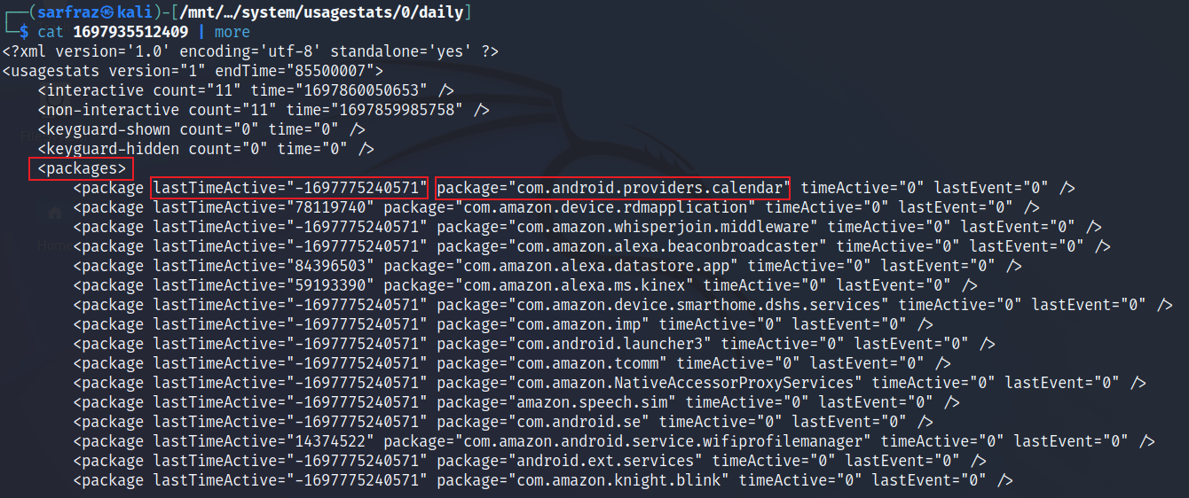
User Activity Statistics
Display contents of file in ‘daily’ directory

Slide 10
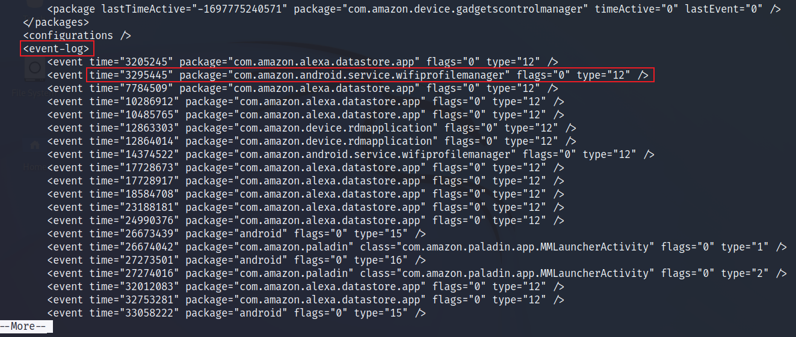
User Activity Statistics
Display contents of file in ‘daily’ directory

Slide 11
User Account Information
In Android and Fire OS, there are two types of storage/directories regarding user account information: system_ce and system_de
‘ce’ stand for credential encrypted and ‘de’ stands for device encrypted
system_ce
Encrypted with the user’s lock screen password
Accessible only after the user unlocks the device
Contains sensitive data, such as account passwords, tokens, and extras
system_de
Encrypted with a default password
Accessible as soon as the device is booted.
Contains basic data, such as account names, types, and flags

Slide 12
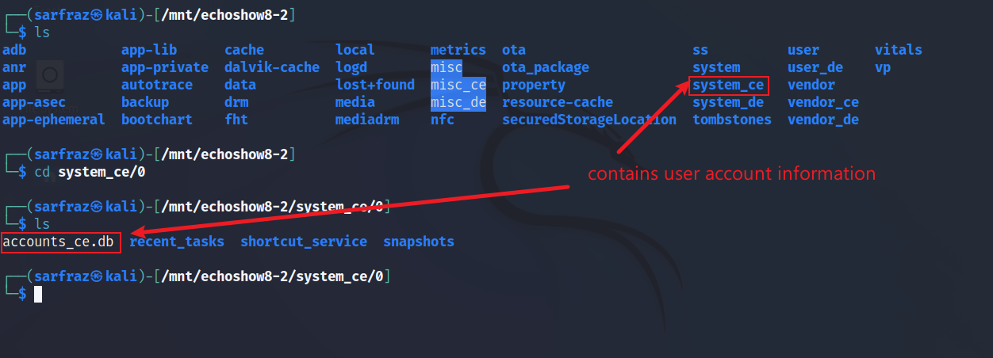
User Account Information – system_ce
List files in /system_ce/0 directory

Slide 13
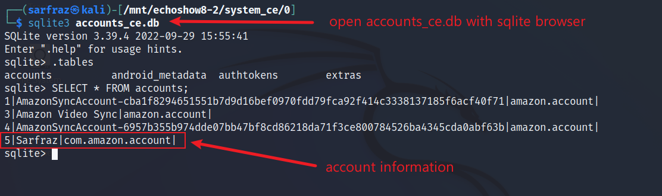
User Account Information – system_ce
Browse accounts_ce.db database file and view ‘accounts’ table

Slide 14
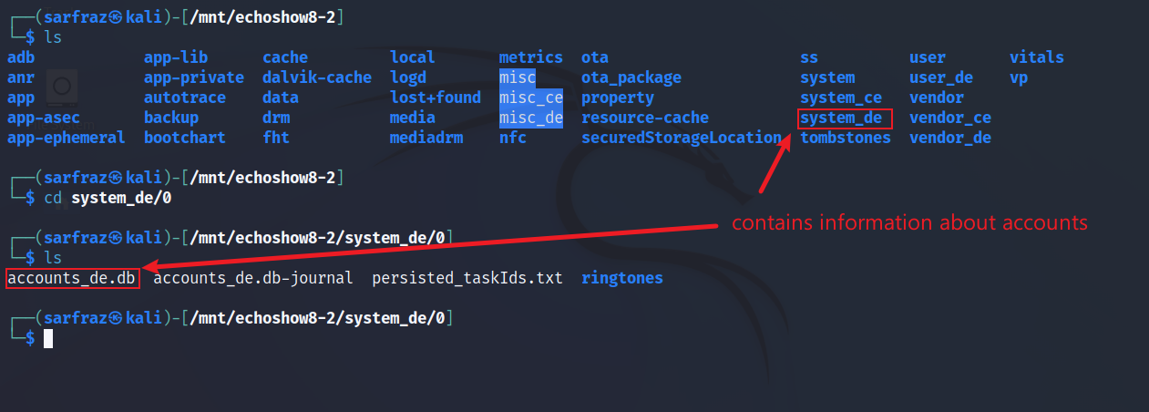
User Account Information – system_de
List files in /system_de/0 directory

Slide 15
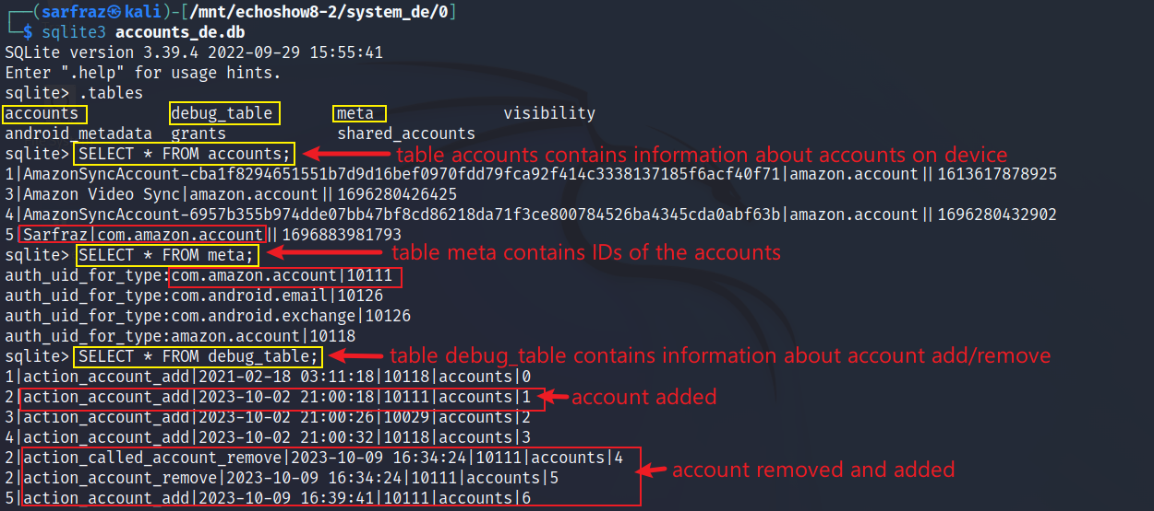
User Account Information - system_de
Browse accounts_de.db database file and view ‘accounts’ table

Slide 16
Data about Recently Used Apps
The /system_ce/0/recent_tasks contains the details of recently used apps
The /system_ce/0/snapshots contains the screenshots of the recently used apps
Recent tasks are stored in XML format
The snapshots are stored in JPEG format.
These have a file name that consists of a task ID followed by extension.
For example, a snapshot file named 123.jpg means that it is the 123rd snapshot of the app.
The snapshots are updated whenever an app is launched or resumed on the device.

Slide 17
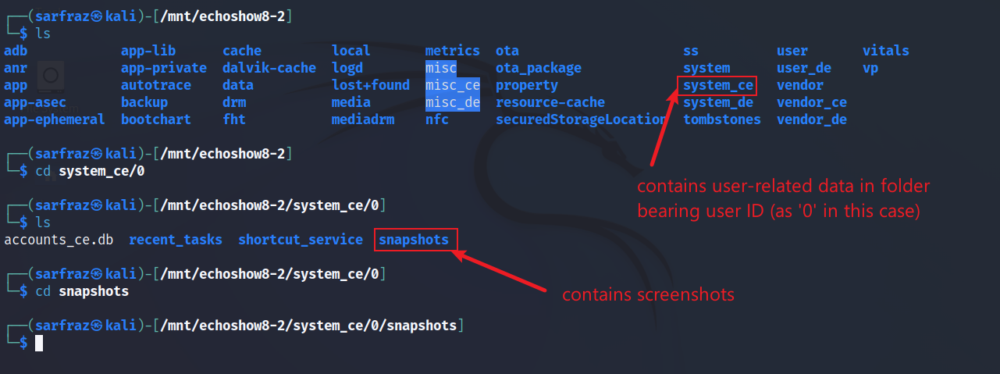
User Activity – Recently Used Apps
List files in /system/system_ce/0 directory

Slide 18
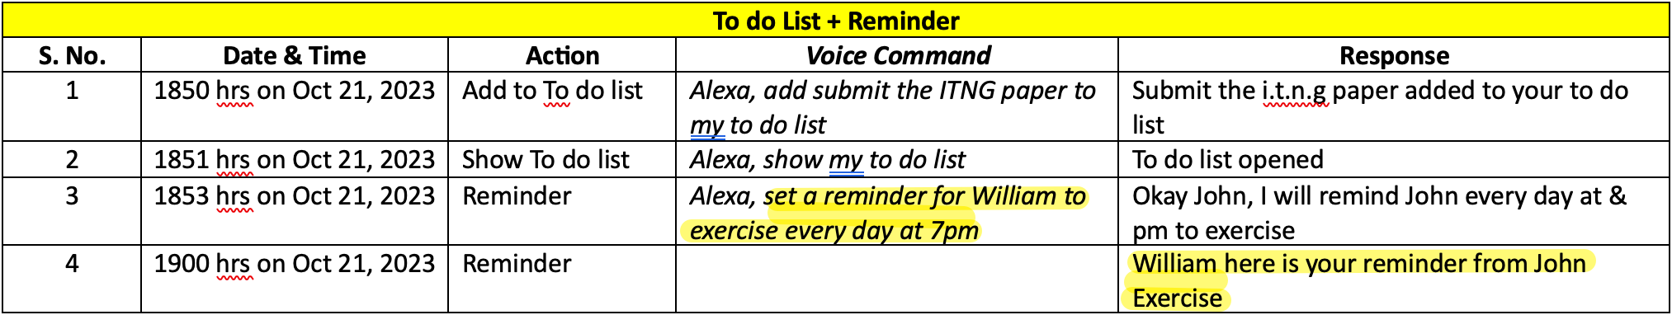
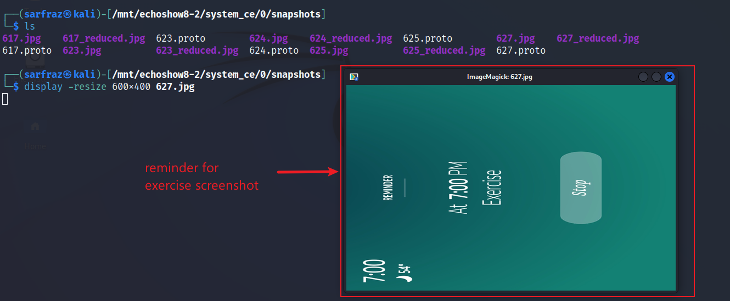
User Activity
Display images (snapshots of reminder)

Slide 19
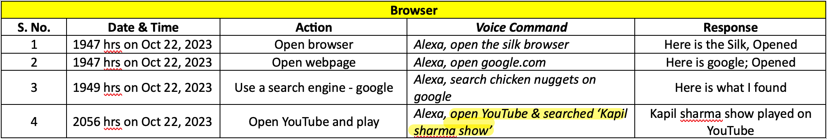
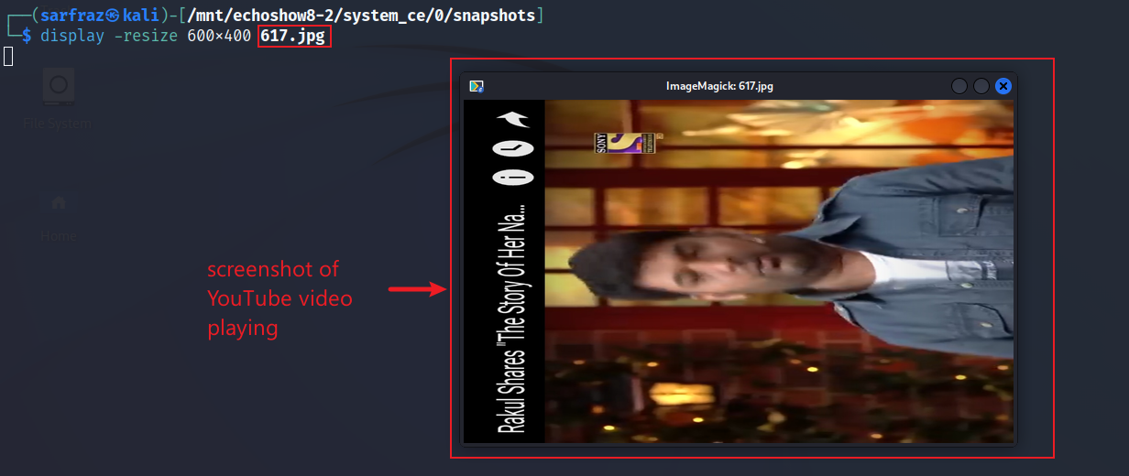
User Activity
Display images (snapshots of YouTube)

Slide 20
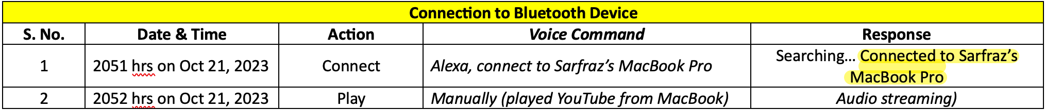
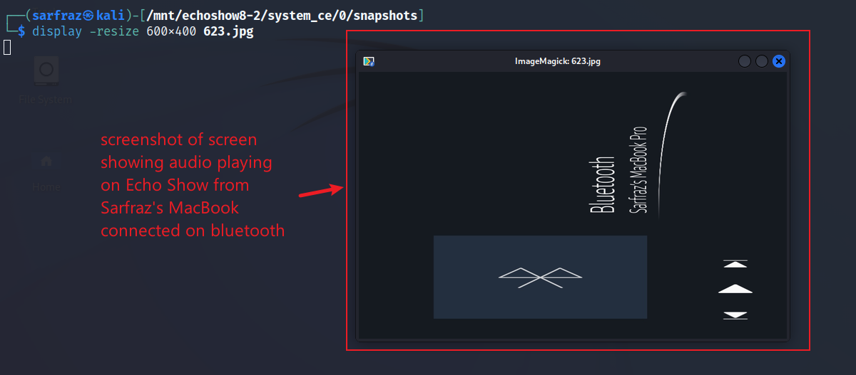
User Activity
Display images (snapshots of Bluetooth Connection)

Slide 21
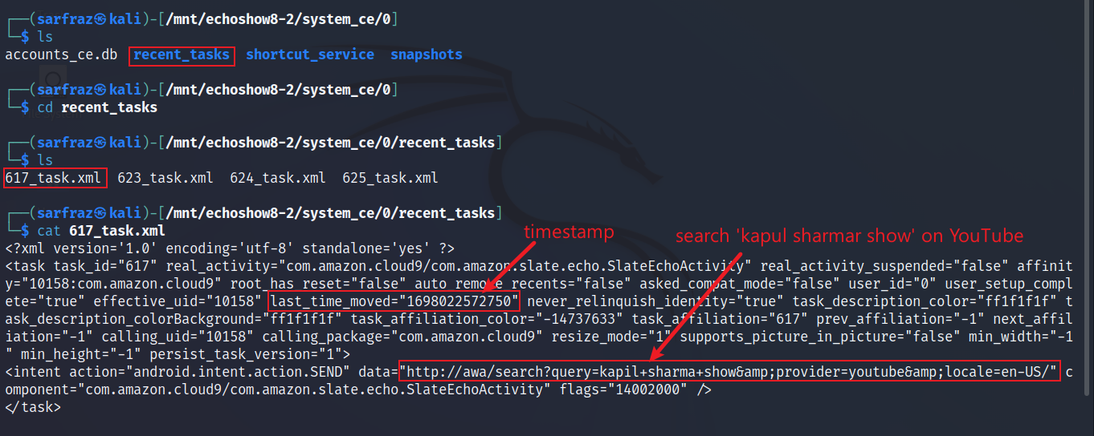
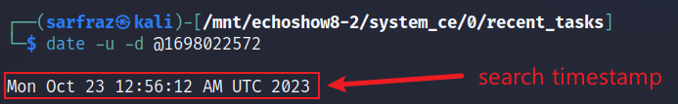
User Activity
Display images (recent activity with YouTube)
Oct 22 8:56 pm EDT
EDT = UTC – 4 hour

Slide 22
Bulk Extractor
A computer forensics tool to extract useful information without parsing the file system or file system structures
Some of the features that bulk extractor can extract are: credit card numbers, Internet domains, Email addresses, Ethernet MAC addresses, IP addresses, telephone numbers, etc
The results are stored in the text files
It also creates histograms of features
Very fast

Slide 23
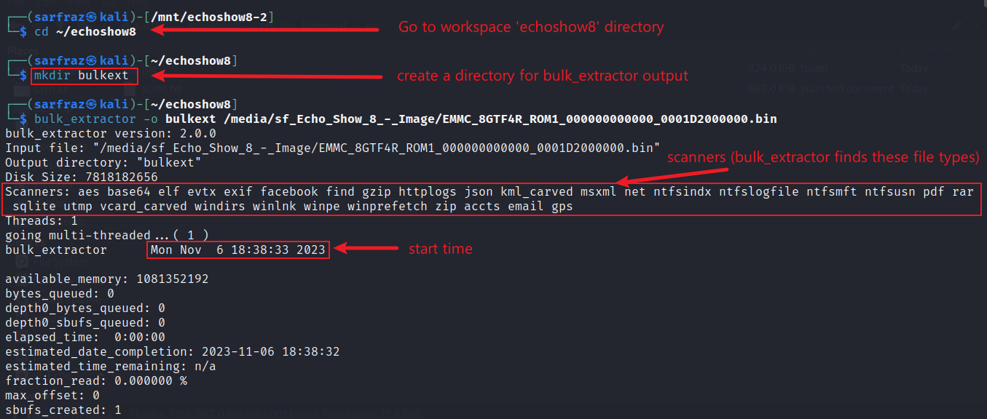
Extraction Process with Bulk Extractor
Create directory and run bulk_extractor command

Slide 24
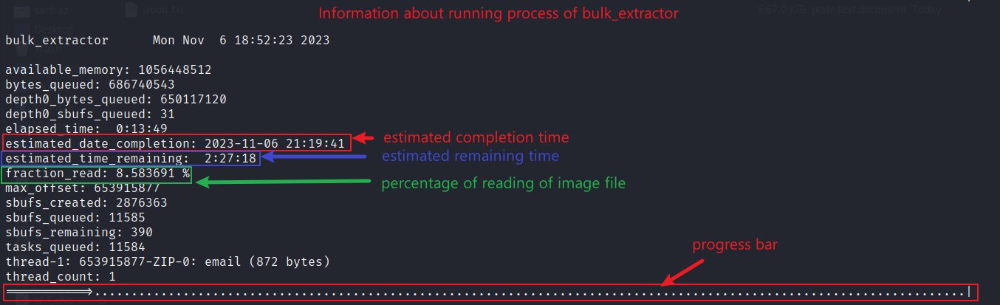
Extraction Process with Bulk Extractor
Bulk_extractor progress

Slide 25
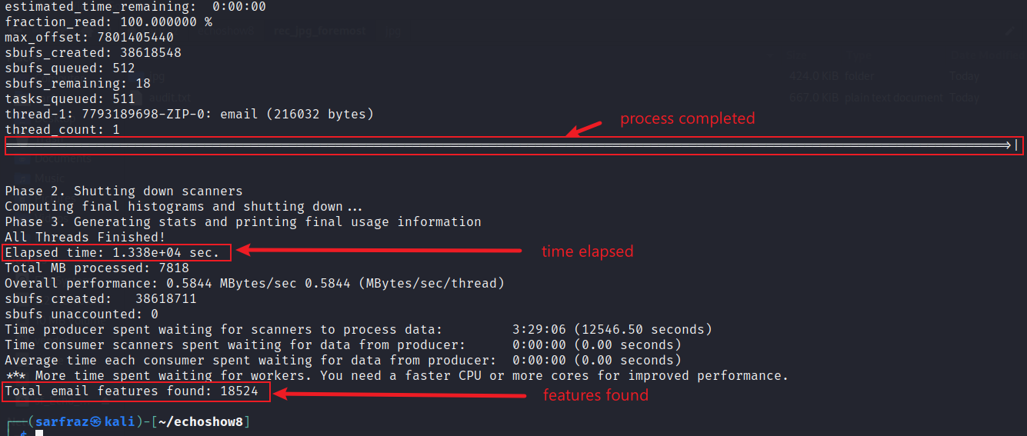
Extraction Process with Bulk Extractor
Bulk_extractor completed

Slide 26
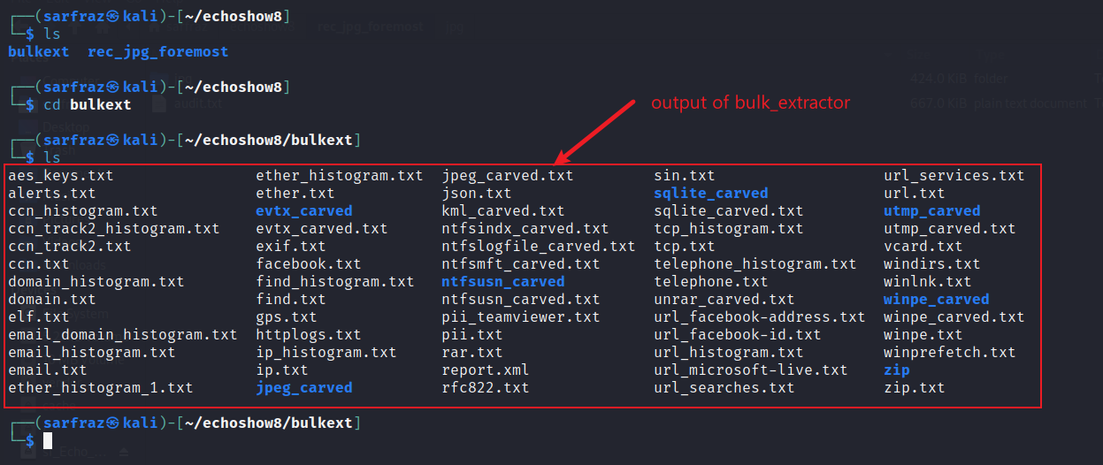
Output of Bulk Extractor
View bulk_extractor output

Slide 27
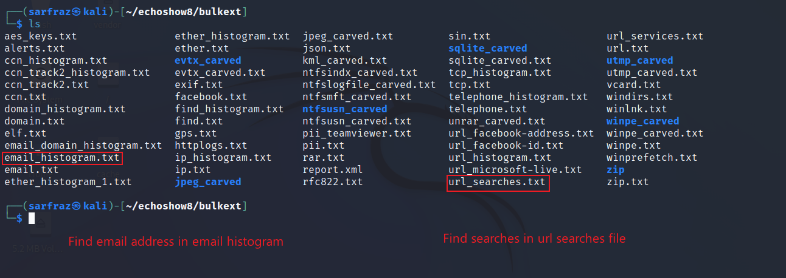
Viewing Extracted Email Addresses
Email and URLs

Slide 28
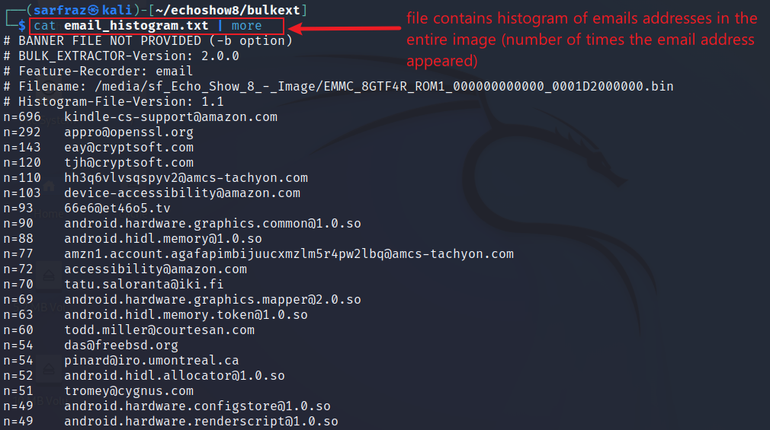
Viewing Histogram of Extracted Email Addresses
Display email histogram

Slide 29
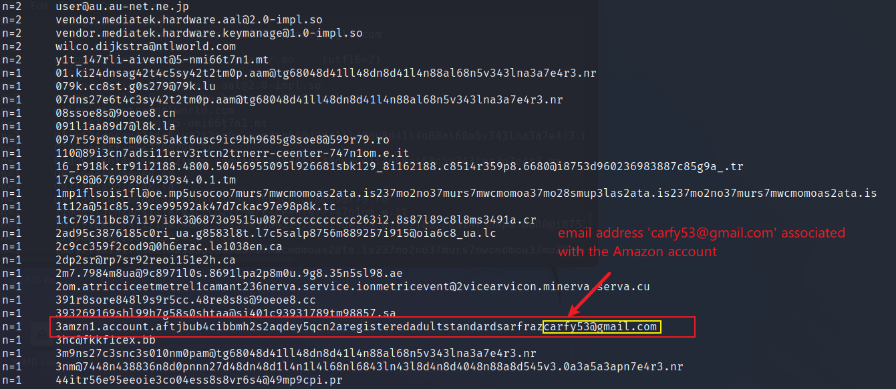
Email Associated with Amazon Account Found!
Display email histogram
The email address associated with the Amazon account is a very important piece of evidence.
This cannot be found in the device file system as Amazon uses the ID to authenticate the device and to ensure the privacy and security of the user
But the bulk_extractor command can find it

Slide 30
com.amazon.kindle.otter.oobe
The purpose of the app com.amazon.kindle.otter.oobe is to provide a great out-of-box experience (OOBE) for Amazon Fire device
OOBE is the process of setting up your device for the first time, such as choosing your language, region, Wi-Fi network, and other preferences
It is used to set up your device settings and preferences during the initial setup process

Slide 31
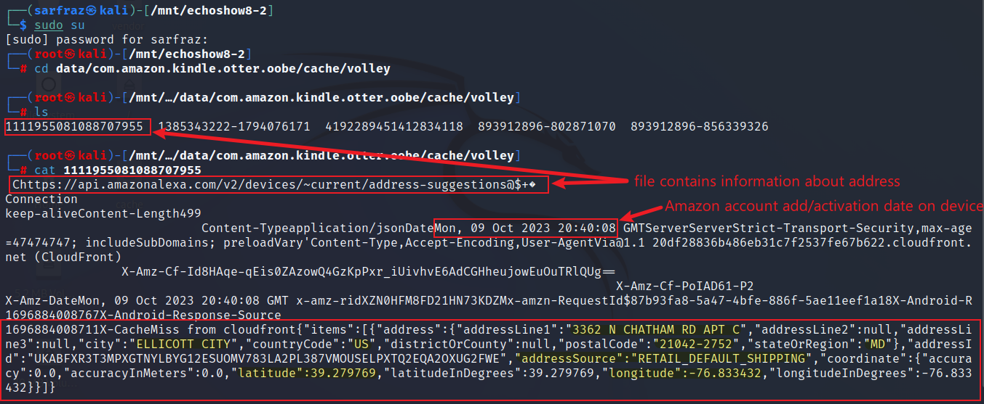
Physical Address Associated with Amazon Account
Go to package com.amazon.kindle.otter.oobe

